Slide 1

Manufacturing Downtime Analysis Project
DEPI_4 Data Analysis Power Bi

Slide 2
Agenda
1) Team Members
2) Project Overview
3) Data Analysis Steps
4) Collecting Data
5) Cleaning
6) Modeling
7)Feature Engineering
8) Visualization Reports
9) Dax
10) Visualization Dashboard

Slide 3

Team Members
Abram Sobhy Bekhit
Osama Khalil Abdel Fadil
Youssef Basher El-Sayed
Fady Milad Sadeq
Jana Ehab Mohamed

Slide 4
Project Overview
This project focuses on analyzing manufacturing production data to understand and reduce production downtime. Downtime refers to the periods when the production line stops due to various operational issues such as machine failures, operator errors, inventory shortages, or process adjustments.
The dataset contains information about production batches, operators, production start and end times, product details, and the factors that caused downtime during the production process.
Using Power BI, the goal of this project is to clean, transform, and model the data in order to build interactive dashboards that help identify the main causes of downtime, measure production efficiency, and support better operational decisions.
By analyzing this data, we can discover patterns in production interruptions, determine the most frequent downtime factors, evaluate operator-related issues, and identify opportunities to improve production performance.

Slide 5
Data Analysis Steps
1) Collecting Data
2) Cleaning
3) Modeling
4) Dax Reports
5) Visualization Reports & Dashboard

Slide 6
Collecting Extra Data
We collected extra data on DEPI data from Kaggle to have enough examples for accurate downtime analysis.
We searched for datasets containing common data quality issues like missing values, product naming errors, end < start, batch duration calculation, outliers, downtime distribution, and factor ranges.
This allows us to perform proper data cleaning, including handling missing values, correcting names, detecting inconsistencies, calculating durations, identifying outliers, and validating ranges.
The goal is to ensure high-quality, consistent data for reliable analysis.
Ultimately, this supports data-driven decisions to improve machine productivity.

Slide 7
Cleaning
Cleaning steps I (Youssef Basher) made:
1/we Appropriate columns data types to avoid any errors
2/from filter we unselect null values from end time column
3/we replace blank values in operator column with unknown
4/we transform table downtime to "unpivot shape" to be clear in visualization
5/we transform values in product column with standard name to each product
6/Remove Duplicate Rows from Downtime Table

Slide 8
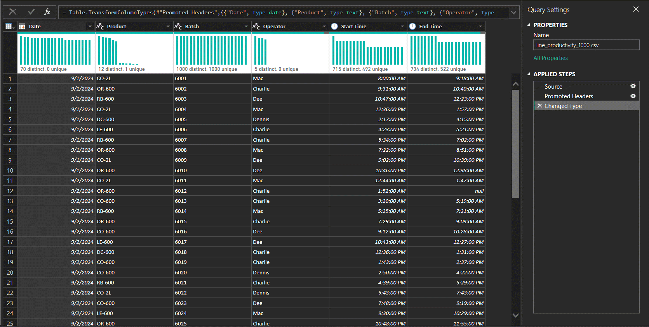
Before

Slide 9
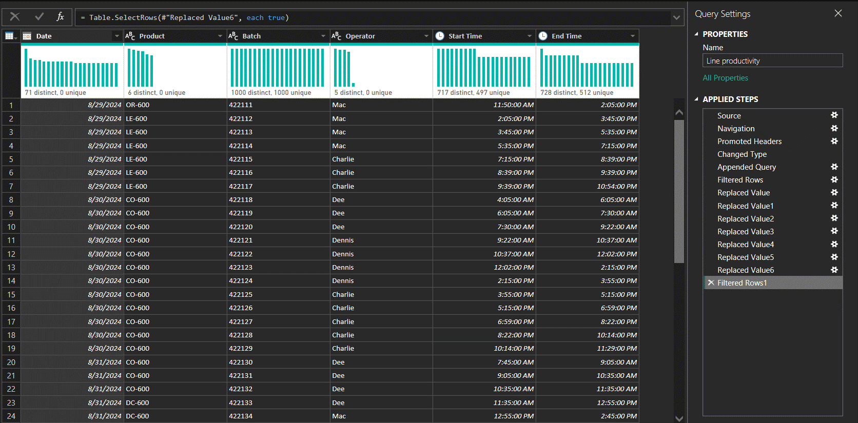
After

Slide 10
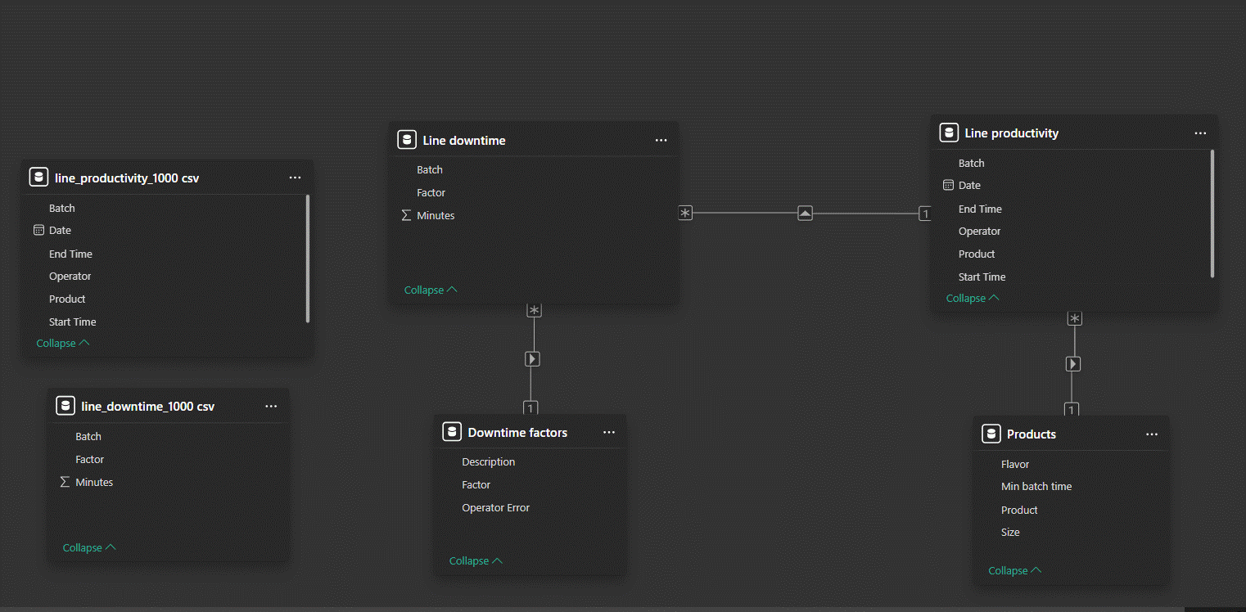
Data Modeling

Slide 11
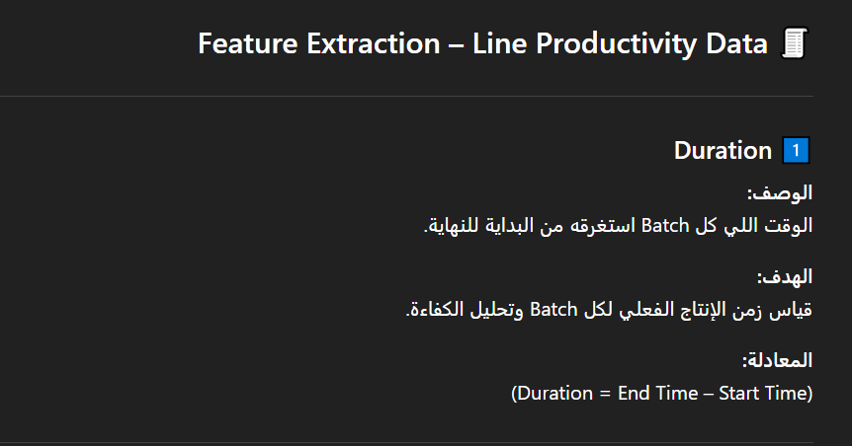
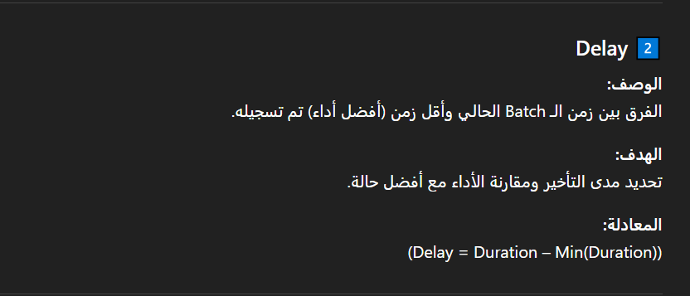
Feature Engineering

Slide 12
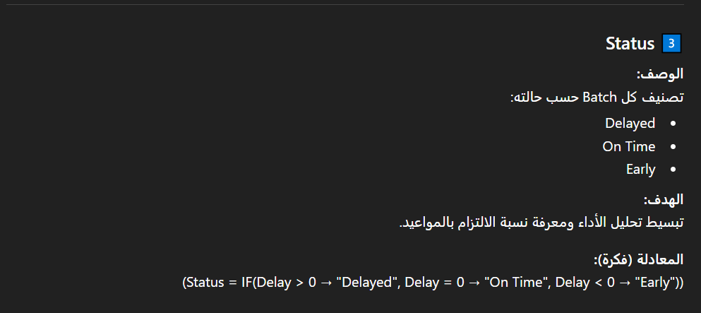
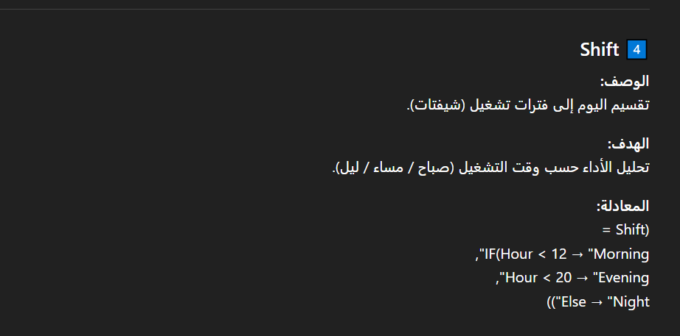

Slide 13
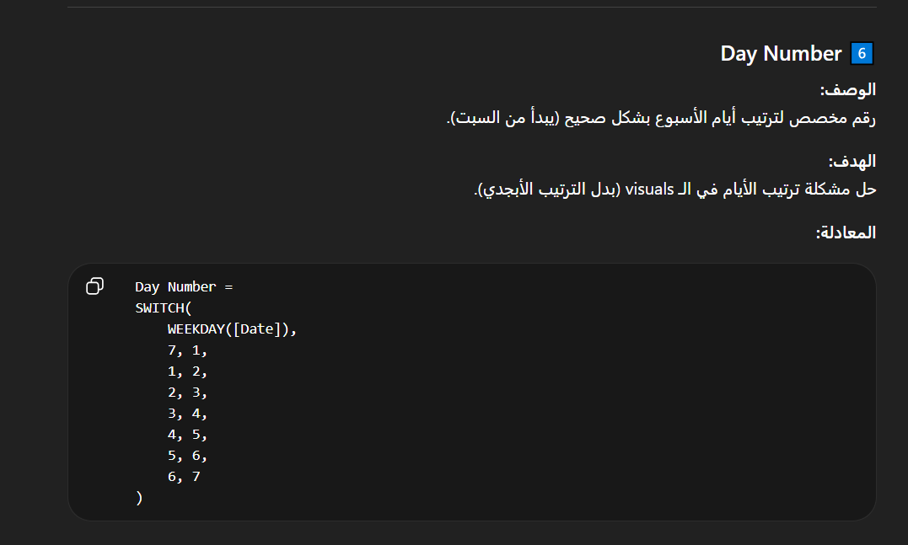


Slide 14
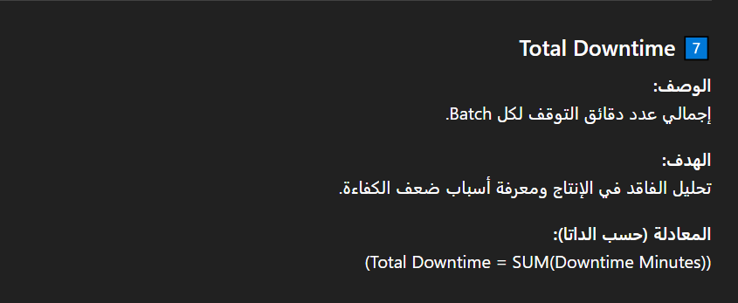
Notes
Columns are calculated at the row level and return a value for each individual record.
Measures are used for aggregations and calculations based on the current filter context.
The Day Number column is used to ensure correct chronological sorting of weekdays in visuals instead of alphabetical order.

Slide 15

Thank You
GitHub Link

